Slide 1
Cloud Patterns and Anti-Patterns
Notes:
Suggested introduction:
Faced with _______
We did _______
And discovered_______

Slide 2
Agenda / Expectations
Not a discussion of features
Focus on Design Patterns impacting the Quality Attributes of a cloud based solution
Provide proven practices for predictable results

Slide 3
Designing for Cloud means…

Slide 4
… Designing a multi-tenant, partition-tolerant solution running on an abstraction against commodity hardware at Internet scale, that is composed of multiple services
Notes:
Multi-tenant. Resources in the platform are shared between different entities, with varying levels of isolation.
Distributed System. Cloud applications are inherently distributed, balancing consistency, availability and partition tolerance.
Abstraction. Cloud applications are developed against various levels of abstraction; virtual machines (IaaS), platform services (storage, compute – PaaS), and software services (media, mobile, messaging, data – SaaS).
Commodity hardware at Internet scale. Cloud platforms are built on top of (relatively) commodity hardware, designed for balancing cost-efficiency and performance in 1000+ machines chunks. The only path to scale is scale-out.
Composed of multiple services. Cloud applications compose services – platform services, application services (stuff you write) and external services (stuff you rent)

Slide 5
Designing a …
DISTRIBUTED SYSTEM
Notes:
The term distributed systems and cloud computing systems slightly refer to different things, however the underlying concept between them is same.
Distributed System. Cloud applications are inherently distributed, balancing consistency, availability and partition tolerance.

Slide 6
Important while Architecting/Designing
SLA
Scalability
Availability
Manageability
Security
Notes:
SLAs are a common way to formally specify the exact conditions (both functional and non-functional) under which services are or should be delivered.
Scalability: Can I add capacity to handle increased demand?
Availability: Will my application endure transient and enduring faults?
Manageability: Do I have ways to understand the health and performance of the live system?
Feasibility: Can I build and maintain the system with my time and cost budget?
Security:

Slide 7
Important while Architecting/Designing
Understanding
Constraints
Notes:
The boundaries, theorems, principles an architect should be aware of

Slide 8
Fallacies of Distributed Computing
1. The network is reliable
2. Latency is zero
3. Bandwidth is infinite
4. The network is secure
5. Topology doesn’t change
6. There is one administrator
8. The network is homogeneous
7. Transport cost is zero
https://en.wikipedia.org/wiki/Fallacies_of_distributed_computing
Notes:
In 1994, Peter Deutsch, a sun fellow at the time, drafted 7 assumptions architects and designers of distributed systems are likely to make, which prove wrong in the long run - resulting in all sorts of troubles and pains for the solution and architects who made the assumptions. In 1997 James Gosling added another such fallacy [JDJ2004]. The assumptions are now collectively known as the "The 8 fallacies of distributed computing"

Slide 9
CAP Theorem
RDBMS
Consistency
Partition Tolerance
Availability
CA
CP
AP
MongoDB
HBase
Redis
CouchDB
Cassandra
DynamoDB

Slide 10
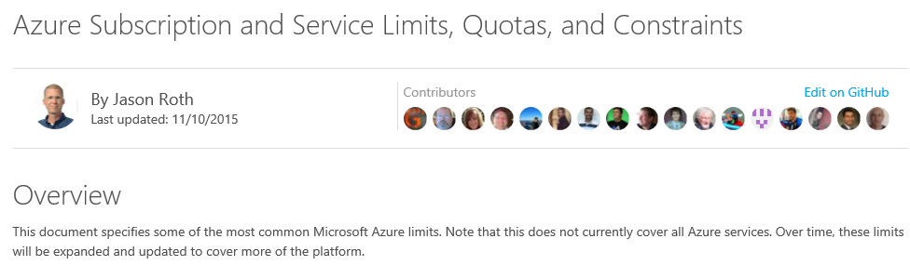
Azure Limits
http://aka.ms/azurelimits

Slide 11
Common Principles and Patterns…

Slide 12
Partitioning
Minimize running costs while maintaining the scalability, performance, availability, and security of the application …
Competing Consumers Pattern
Compute Resource Consolidation Pattern
Compute Partitioning
Leader Election Pattern
Sharding Pattern
Index Pattern
Data Partitioning
Materialized View Pattern
CQRS
Event Sourcing
Data Consistency

Slide 13
Asynchronous Messaging
Key Strategy To Build Scalable And Resilient Solutions…
Queue-based Load Leveling Pattern
Circuit Breaker Pattern
Priority-Queue Pattern
Retry Pattern

Slide 14
Caching
Common Technique to improve the Performance and Scalability…
Cache-Aside Pattern
1
2
3

Slide 15
Availability and Flexibility
Monitor and adapt to optimize operations and cost…
Health Endpoint Monitoring Pattern
Management / Monitoring
Runtime Reconfiguration Pattern
Throttling Pattern
Scaling
Pipes & Filters Pattern
Notes:
Constantly monitoring performance and scaling a system to adapt to fluctuating workloads to meet capacity targets and optimize operational cost can be a labor-intensive process. It may not be feasible to perform these tasks manually. This is where auto-scaling is useful.

Slide 16
Security
Techniques to increase Security…
Gatekeeper Pattern
Valet Key Pattern
Federated Identity Pattern
Multi-Factor Authentication

Slide 17
Partitioning
The only way to achieve “infinite” scale …

Slide 18
Partitioning Data (spillover)
Start with 1 partition, fill it, then move to next
headroom {
(fill factor)

Slide 19
Partitioning Data (range)
Keep current data hot, Warm historical data, Scale-down older data, Purge / Archive
X
}
current
period

Slide 20

Partitioning Data (lookup)
Home tenant / user to a specific partition. Use “master” lookup.
Cache this shard map
Tenant | Partition Id
Customer | 1
Big Customer | 2
Another | 3
to avoid making the lookup the bottleneck

Slide 21
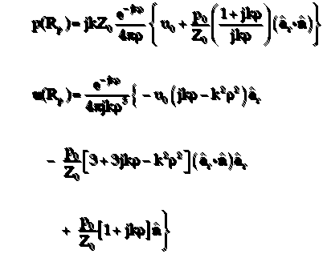
Partitioning Data (hash)
Evenly distribute across n number of partitions (algorithmic) ….
n = n + m

Slide 22
Customer Stories…

Slide 23
Photo Sharing Service “Share your life with friends and family”

Slide 24
It’s monochrome fashion
Cloud storage with image processing capability
Unlimited storage with thumbnails and image correction
First release had a limit of 50 request per sec
Target was 7,000 request/s
Monolithic architecture with a few major issues
Need distributed system principles in place
Monoglot persistence using SQL for all data
Need storage optimization

Slide 25
Monolithic, Synchronous and Monoglot
Web role
Web role
Service 1
User profile
SQL DB
Instantiate a new HttpClient per every request
Service 2
Image processing
Client
Gateway
….
Other services
Notes:
Compute Resource Consolidation Pattern

Slide 26
Refactoring to gain x150 performance
Monolithic architecture
Decomposed workload, Moved CPU intensive tasks to worker role
Synchronous I/O calls across architecture
Changed to async calls
SQL DB for every data type
Optimized the storage for each entity
Lack of caching
Added caching between app and data tier
Instantiating objects per every call
Changed to singleton or object pooling

Slide 27
Distributed, Asynchronous and Polyglot
Decompose the workloads into different roles
Optimal storage per each data type
Web role
Web role
User profile service
Cache
SQL DB
Use a shared instance of HttpClient
Web role
Client
Gateway
Other services
Table Storage
Web role
Worker role
Image processing
service
Image processing
Blob Storage
Async calls all around
Use queue and worker for CPU intensive task

Slide 28
Movie Streaming “Now showing on Azure”

Slide 29
Cache Me If You Can
Viewers
Public Broadcast Provider
Media streaming (TV, Radio)
Program, Metadata, Statistics shown on website
Heavily using Caches, migrated to Azure Redis Cache from Managed Cache Service
Caches movie metadata
If remote cache query > 2s, query database directly
Web Role
…
Data
Client
Data
Client
Data
Client
Managed Cache
(Redis)
DB
Movie Metadata
Azure Blob
…
Movies

Slide 30
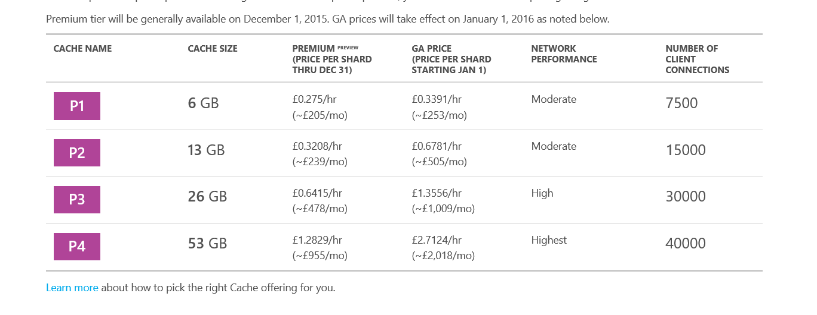
More than just size
Caching about 2-3 GB of data
Web Role
…
Data
Client
Data
Client
Data
Client
Managed Cache
(Redis)
DB
Movie Metadata
Azure Blob
…
Movies
Notes:
What happened? Just putting about 2GB of data in Cache, but Cache started throttling and throwing exception.
Issue: network bandwidth saturation!!

Slide 31
Working around?
Partitioning!
Add another Layer of Caching!
Web Role
Cache
Cache
…
Cache
Data
Client
Data
Client
Data
Client
Cache (User Data)
Cache (Media Data)
Azure Redis Cache – User data, Media data, Service data
DB
Cache (Services Data)
Movie Metadata
Azure Blob
…
Movies

Slide 32
Cache Lookup
var cache = Connection.GetDatabase();
var value = await GetAsync<T>(cache, key).ConfigureAwait(false);
if (value == null)
{
value = await loadCache().ConfigureAwait(false);
if (value != null)
{
await SetAsync(cache, key, value,
aspirationTimeInMinutes).ConfigureAwait(false);
}
}
return value;

Slide 33
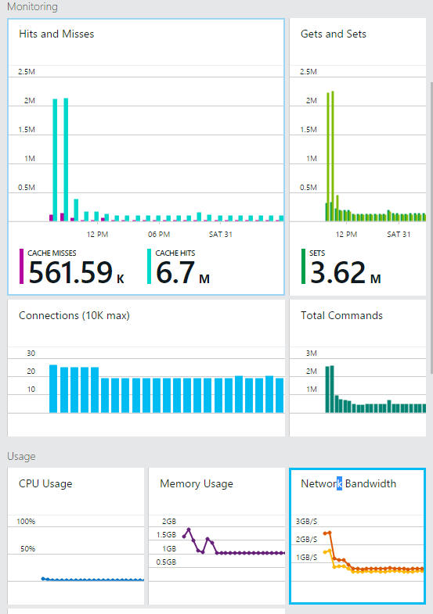
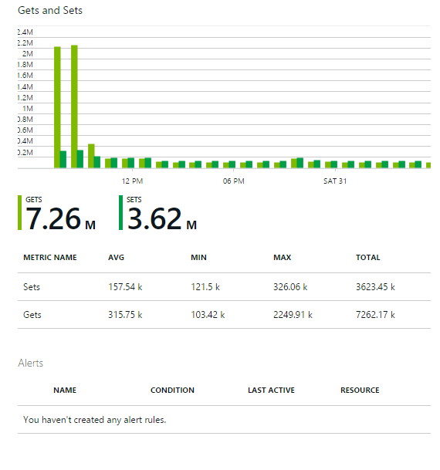
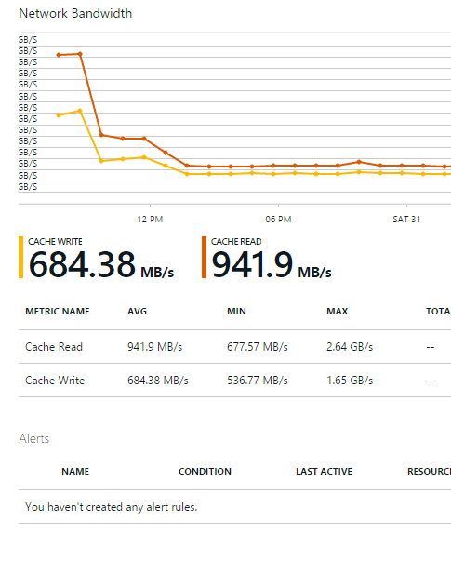
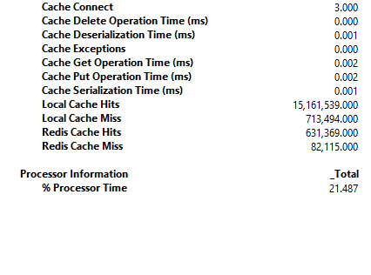
An Extra Cache in Action

Slide 34
Data Upload to Azure DB “Chew on this…”

Slide 35
What Does the Data Say?
Leading software company for advertising monetization created hybrid PaaS Azure solution
Architecture includes:
Daily activity and transaction history .csv file upload to Azure storage
Import to Azure DB
Trailing 7-day aggregate view for analytics and
trending with HDInsight and prediction with CloudML
Ingestion Worker Role
Azure DB
Results
Azure
Blob
…
…
On-Prem Data Sources

Slide 36
Any Day Now…
Source data was over 100 CSV files between 10MB and 1.4 GB
Average total ingest was around 40 GB
Customer wrote custom ETL process using SqlBulkCopy
Problem: ingest took around 37 hours
Realization: Azure DB is a scale-out architecture

Slide 37
Keeping Up in Three Parts
1: move to Azure DB Premium
2: parallelize data upload by scaling the worker role to multiple streams
3: create one table/day, view aggregates week of data
Result: optimized upload in < 3 hours
Today
Ingestion Worker Role
…
1
2
3
8
Today-1
Aggregate
…
Today-6
Azure
Blob
…
Azure DB
X
Today-7
On-Prem Data Sources

Slide 38
Migration to PaaS “Tired of maintaining VMs”

Slide 39
To The Cloud!
Customer: software development company that produces solutions for the design, construction and operation of building, plant, civil, and geospatial infrastructure
Goal: move existing multi-tier application to the cloud
.NET, SQL
Leverage PaaS where possible
Match performance of existing deployment

Slide 40
Let’s Start Here
Web Role
1
2
…
n
PaaS design:
ASP.NET moved to Web Role
Application logic moved to Worker Role
SQL moved to IaaS SQL mirror
Scale testing results were … disappointing:
Application Worker Role
IaaS
SQL
 | 200 User Test
 | On-Prem App | Azure
Total Counts For Test 1 (batch): | 33,174 | 10,135
Total Counts For Test 2 (interactive): | 114,497 | 39,341

Slide 41
Let’s Try This Instead…
On-prem architecture had combined web/app server
Inter-role communication introduced extra cross-server communication
Optimization: collapse Azure Web and Worker roles
Storage not optimized for IaaS SQL usage
Initial Configuration
Optimized Configuration
Data.VHD
Tempdb.VHD
Data+Tempdb.VHD
1844 IOPS 15.26 MB/sec
5379 IOPS
336.15 MB/sec

Slide 42
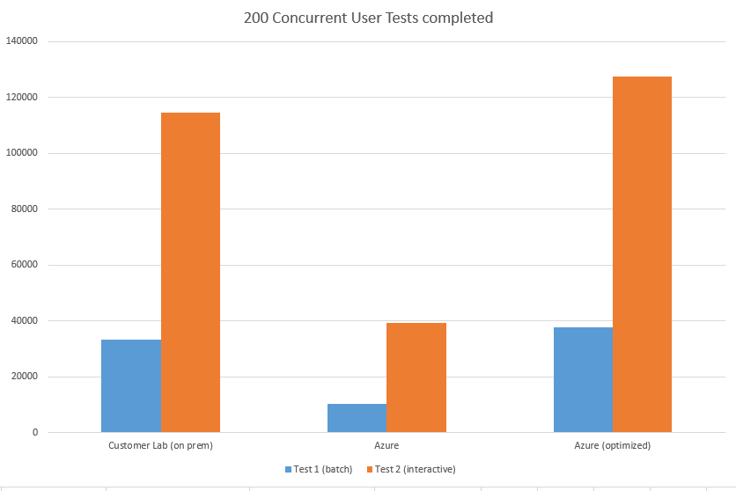
That Did the Trick
Performance tests of optimized configuration showed great performance:
Concurrent Users

Slide 43
Connected Cars “Calling all cars”

Slide 44
Connecting Azure with the World
Large connected car services company created new service on Azure
Goal: leverage Azure PaaS services
Dedicated Cache Worker Role
…
DB
NotificationsWorker Role
…
Admin Web Role
Message Processor Worker Role
…
User Services Web Role
Operations Service Bus Queue
Azure Blob
…

Slide 45
One By One
Performance measurements showed message process far less than 10,000/s required
Challenge:
Synchronous message processing
Solution:
Asynchronous (batch) receive
Message Processor
Message 3
Message 2
Message 1
Message 1
Message 2
Message Processor
Message 3

Slide 46
Remove One Bottleneck, Find Another
Challenge:
Processing one by one
Solution:
Concurrent processing
Message 1
Message Processor
Message 2
Processed Message 3
Processed Message 2
Processed Message 1
Message 3
Processed Message 1
Message 1
Message Processor
Processed Message 2
Message 2
Message 3
Processed Message 2

Slide 47
Serial
public override void Run()
{
// Initiates the message pump and callback is invoked for each message. Close Pump
Client.OnMessage((receivedMessage) =>
{
try
{
var batchId = receivedMessage.Properties["Batch"].ToString();
var processingDelay =
int32.Parse(receivedMessage.Properties["ProcessingDelay"].ToString());
Thread.Sleep(processingDelay);
_progressTracker.RegisterMessageProcessedAsync(batchId + QueueName).Wait();
}
catch
{
// Handle any message processing specific exceptions here
}
});
CompletedEvent.WaitOne();
}

Slide 48
Batch
public override void Run()
{
client.OnMessageAsync(async (receivedMessage) =>
{
try
{
var batchId = receivedMessage.Properties["Batch"].ToString();
var processingDelay =
Int32.Parse(receivedMessage.Properties["ProcessingDelay"].ToString());
await Task.Delay(processingDelay).ConfigureAwait(false);
await _progressTracker.RegisterMessageProcessedAsync(batchId + QueueName);
}
catch
{ // Handle any message processing specific exceptions here
}
}, new OnMessageOptions() { MaxConcurrentCalls = 50 });
CompletedEvent.WaitOne()
}

Slide 49
Inserting entities into Table Storage
Notes:
1_Storage_Table_Insert.docx

Slide 50

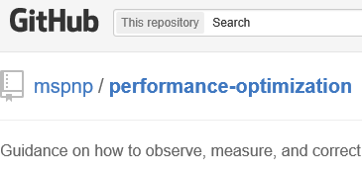
Conclusion
http://aka.ms/cloudpatterns
https://github.com/mspnp/performance-optimization

